Slide 1
ACROPOLIS-BeFinD Dissemination Seminar
Domestic Resource Mobilization in Burkina Faso: Welfare Effects of VAT Reforms
Romain Houssa, Kelbesa Megersa and Bart Capeau
18 October 2018, Ouagadougou

Slide 2
Introduction
Financing for development (Monterrey Consensus)
Huge-resource gap required in LICs (DMDF, 2015)
Focus on taxation (e.g. Addis Tax Initiative, 2015)
  relatively more stable
  enhances state building and strengthen the state-citizen relationships (Tilly 1975)

Slide 3
Introduction (www.glo-be.be)
  « Les citoyens qui payent un impôt au gouvernement attendent un retour. Ça passe ou ça casse ! Soit il y a un retour tangible (écoles, routes, hôpitaux, infrastructures et services,…) et la population est satisfaite de voir son bien-être et sa qualité de vie augmenter. Cela crée alors un effet catalyseur très positif pour les recettes fiscales et donc pour le financement du développement. Ainsi, le citoyen rechigne moins à payer ses taxes. Il est même enclin à contribuer parce qu’il constate qu’il en retire un bénéfice pour lui et sa famille. Soit il n’y a pas de retour de la part des pouvoirs publics : l’argent est détourné, la corruption règne, le budget est mal utilisé. Dans ces conditions, les citoyens ne seront plus d’accord de payer leurs impôts : les taxes sont contournées, il y a de la fraude fiscale, le travail au noir est la règle. »

Slide 4
Introduction
Economic Development
Tax collection
Institutions

Slide 5
Tax Revenue in WAEMU

Slide 6
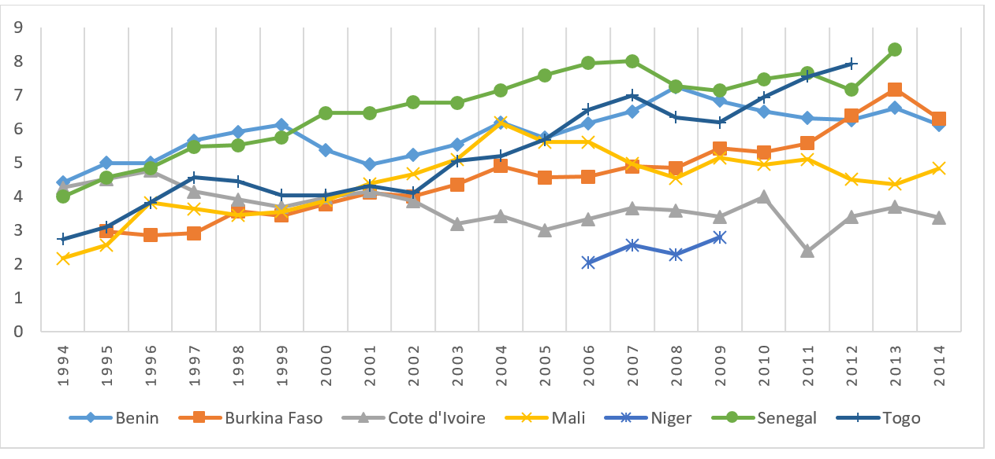
VAT Revenue in WAEMU

Slide 7
Why is VAT important?
VAT is relatively easy to administer ➔ Less prone to tax evasion
Suitable for developing countries
  less sensitive to the informal market
  If well designed, it can even reduce the size of the informal sector
Less distortionary among taxes
  In comparison with income taxes, VAT does not change consumption decisions relative to savings and investment decisions
No cascading effects
  Unlike other consumption taxes
  Tax on a commodity is charged at separate stages of the production process without deductions
  Sellers or firms paying VAT, can receive credit for the VAT paid on intermediate inputs
  Allows to achieve production efficiency (Diamond-Mirrlees theorem)

Slide 8
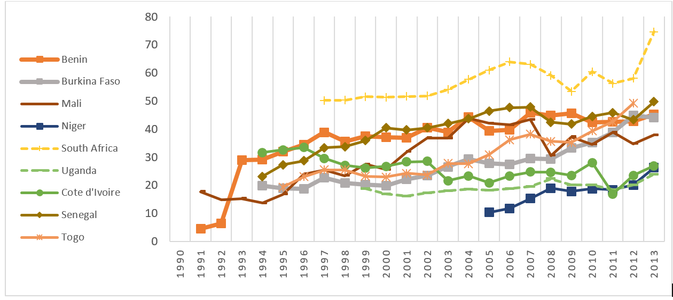
VAT efficiency in selected countries

Slide 9
Policy (Research) Objectives at BeFinD
http://www.befind.be/publications/taxes
  The principles of tax design & State of Domestic Resource Mobilization (DRM)
  Taxation of multilateral companies
  The role of Value Added Tax (VAT) for DRM
  Assessing rooms for improvement in VAT systems
  The role of institutions for DRM
  Design VAT reforms for WAEMU: case study of BFA

Slide 10
Welfare effects of VAT reforms in BFA
  Reforms: eliminate VAT exemptions/zero rates and/or to increase the VAT rate on a number of consumption items.
  These policies, however, could potentially affect differently the income classes in the society and may lead to increasing inequality.
  We develop a tool (micro-simulation model): BFATAX
    evaluate policy impact on
      government revenue
      welfare cost across the poor and rich households.
      Excess burden?

Slide 11
Outline
I. BFATAX
II. Data
III. Empirical results
IV. Conclusing Remarks

Slide 12
I.
BFATAX: Microsimulation for Evaluating tax reforms in BFA

Slide 13
Microsimulation
Microsimulation models allow to analyze impacts of changes in policies related to taxation and benefits
Evaluate tax reforms
  not only after they have been implemented (i.e. ex-post)
  but also before potential reforms that are in the pipeline are implemented, i.e. ex-ante
e.g. EUROMOD (Decoster et al., 2011; Capeau et al., 2014)

Slide 14
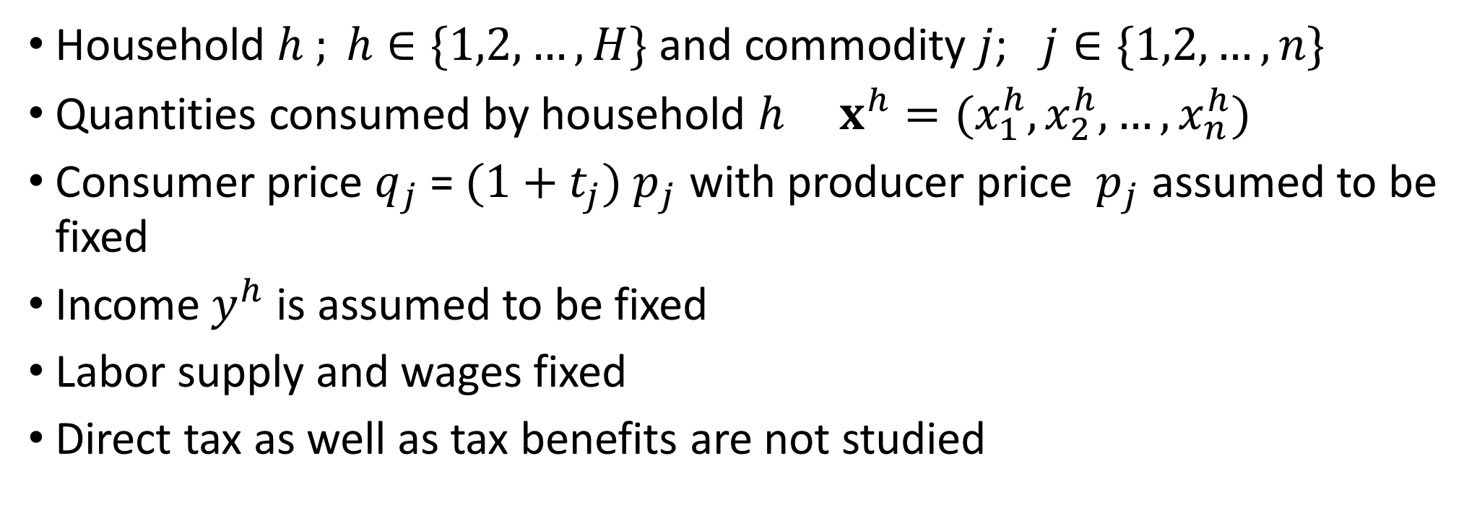
Model
Household $h ; h∈\{1,2,…,H\}$ and commodity $j$; $j∈\{1,2,…,n\}$
Quantities consumed by household $h$ $x^{h}=(x_{1}^{h},x_{2}^{h},…,x_{n}^{h})$
Consumer price $q_{j}$= $(1+t_{j})$ $p_{j}$ with producer price $p_{j}$ assumed to be fixed
Income $y^{h}$ is assumed to be fixed
Labor supply and wages fixed
Direct tax as well as tax benefits are not studied

Slide 15
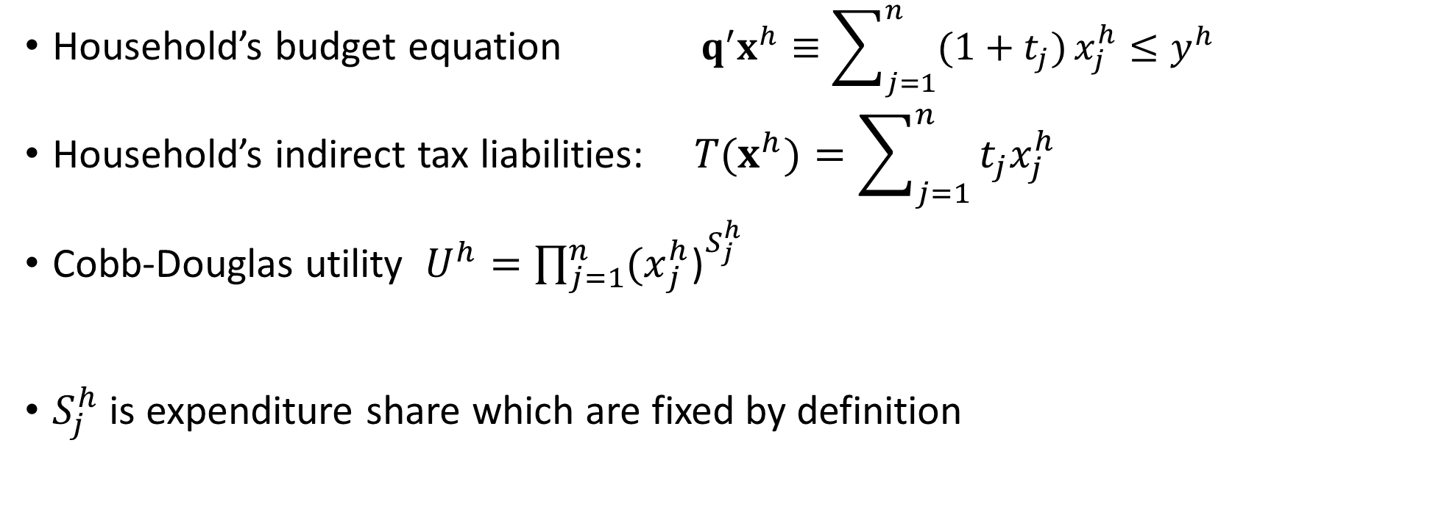
Model
Household’s budget equation $q^{′}x^{h}≡\sum_{j=1}^{n}{(1+t_{j})}x_{j}^{h}≤y^{h}$
Household’s indirect tax liabilities: $T(x^{h})=\sum_{j=1}^{n}{t_{j}x_{j}^{h}}$
Cobb-Douglas utility $U^{h}=\prod_{j=1}^{n}{{{(x}_{j}^{h}\text{)}}^{{S_{j}^{h}}_{}}}$
$S_{j}^{h}$ is expenditure share which are fixed by definition

Slide 16
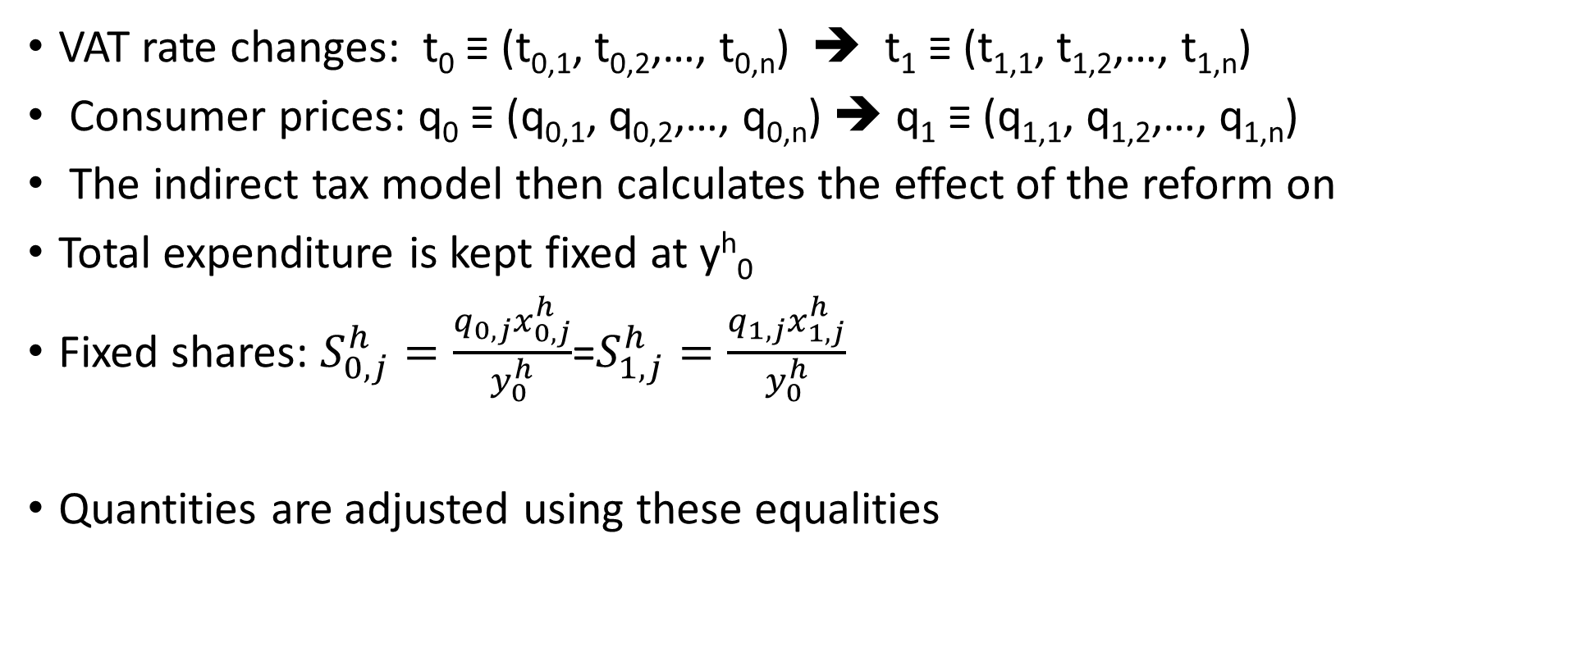
Reforms designed
VAT rate changes: t₀ ≡ (t_{0,1}, t_{0,2},…, t_{0,n}) ➔ t₁ ≡ (t_{1,1}, t_{1,2},…, t_{1,n})
Consumer prices: q₀ ≡ (q_{0,1}, q_{0,2},…, q_{0,n}) ➔ q₁ ≡ (q_{1,1}, q_{1,2},…, q_{1,n})
The indirect tax model then calculates the effect of the reform on
Total expenditure is kept fixed at y^{h}₀
Fixed shares: $S_{0,j}^{h}=\frac{q_{0,j}x_{0,j}^{h}}{y_{0}^{h}}$=$S_{1,j}^{h}=\frac{q_{1,j}x_{1,j}^{h}}{y_{0}^{h}}$
Quantities are adjusted using these equalities

Slide 17
Reforms designed
Remove all zero VAT rates and apply 18%
Replace the zero rate by 5%
Keep zero rate but do the following
  10 % : Foodstuffs, Electricity, gas, water, Transport, Post and Telecom.
  Public services
  20%: Articles of wood and metal, Cotton, textiles and clothing
  Petroleum products and chemicals
  25%: Financial services, Hotel and restaurant services
  Other commercial services

Slide 18
II.
DATA: Enquête multisectorielle du Burkina 2013-2014

Slide 19
About 10.0000 households by regions
Region | Households (% )
Hauts-Bassins | 11.34
Boucle du Mouhoun | 8.76
Sahel | 6.23
Est | 8.14
Sud-Ouest | 5.34
Centre Nord | 7.29
Centre-Ouest | 8.30
Plateau-Central | 4.36
Nord | 6.11
Centre-Est | 8.73
Centre | 16.03
Cascade | 4.67
Centre-Sud | 4.68
Total | 100

Slide 20
Per capita Expenditure (CFA) by provinces

Slide 21
Data analysis
Data issues : total expenditure not equal to sum of ind. Expenditures
About 213 goods: 13000 goods
Analysis excludes durable goods

Slide 22
Share of specific durable items in total household consumption expenditure, by decile

Slide 23
Share of major expenditure categories in total household consumption expenditure, by decile
Decile | 1 | 2 | 3 | 4 | 5 | 6 | 7 | 8 | 9 | 10 | Total
100 Articles of wood and metal | 3.12 | 3.49 | 3.24 | 3.60 | 3.46 | 3.68 | 3.26 | 3.83 | 4.20 | 4.23 | 3.61
100 exempt | 0.00 | 0.00 | 0.00 | 0.00 | 0.00 | 0.00 | 0.00 | 0.00 | 0.00 | 0.00 | 0.00
10 Agricultural products | 0.00 | 0.00 | 0.00 | 0.00 | 0.00 | 0.00 | 0.00 | 0.00 | 0.00 | 0.00 | 0.00
10 exempt | 23.64 | 19.55 | 18.84 | 18.68 | 17.97 | 17.21 | 18.34 | 17.05 | 15.71 | 15.26 | 18.17
110 Electricity, gas, water | 0.52 | 0.31 | 0.33 | 0.55 | 0.54 | 0.79 | 0.82 | 1.34 | 1.99 | 1.88 | 0.91
110 exempt | 0.97 | 0.64 | 0.61 | 0.71 | 0.69 | 0.80 | 0.99 | 1.07 | 1.11 | 1.10 | 0.87
120 Construction works, installation works | 0.03 | 0.02 | 0.01 | 0.02 | 0.02 | 0.03 | 0.06 | 0.04 | 0.10 | 0.10 | 0.04
120 exempt | 0.00 | 0.00 | 0.00 | 0.00 | 0.00 | 0.00 | 0.00 | 0.00 | 0.00 | 0.00 | 0.00
130 Trade | 5.47 | 6.20 | 7.03 | 7.80 | 8.83 | 8.35 | 8.54 | 9.12 | 9.93 | 9.69 | 8.12
130 exempt | 0.04 | 0.01 | 0.02 | 0.01 | 0.02 | 0.02 | 0.03 | 0.02 | 0.02 | 0.02 | 0.02
140 Hotel and restaurant services | 3.11 | 3.20 | 3.87 | 4.21 | 4.49 | 4.42 | 5.49 | 5.38 | 5.72 | 5.78 | 4.58
140 exempt | 0.00 | 0.00 | 0.00 | 0.00 | 0.00 | 0.00 | 0.00 | 0.00 | 0.00 | 0.00 | 0.00
150 Transport, Post and Telecommunications | 6.92 | 7.63 | 7.77 | 8.23 | 8.87 | 8.68 | 9.04 | 8.90 | 9.76 | 9.20 | 8.51
150 exempt | 0.00 | 0.00 | 0.00 | 0.00 | 0.00 | 0.00 | 0.00 | 0.00 | 0.00 | 0.00 | 0.00
160 Financial services | 0.01 | 0.02 | 0.02 | 0.01 | 0.01 | 0.03 | 0.02 | 0.10 | 0.14 | 0.19 | 0.06
160 exempt | 0.00 | 0.00 | 0.00 | 0.00 | 0.00 | 0.00 | 0.00 | 0.00 | 0.00 | 0.00 | 0.00
170 Other commercial services | 6.73 | 7.40 | 6.95 | 6.51 | 6.33 | 6.19 | 5.54 | 5.37 | 5.15 | 5.56 | 6.17
170 exempt | 1.40 | 1.37 | 1.37 | 1.51 | 1.67 | 2.01 | 2.44 | 2.76 | 2.56 | 3.45 | 2.06
180 Public services | 0.03 | 0.02 | 0.05 | 0.08 | 0.05 | 0.07 | 0.07 | 0.08 | 0.12 | 0.16 | 0.07
180 exempt | 7.67 | 7.11 | 6.91 | 6.44 | 6.01 | 6.04 | 5.30 | 5.52 | 6.22 | 6.44 | 6.36
20 Livestock products | 0.00 | 0.00 | 0.00 | 0.00 | 0.00 | 0.00 | 0.00 | 0.00 | 0.00 | 0.00 | 0.00
20 exempt | 2.05 | 2.48 | 2.51 | 2.80 | 3.37 | 3.49 | 3.56 | 3.51 | 3.42 | 3.33 | 3.06
30 Products of forestry - Fishing - Hunting | 0.00 | 0.00 | 0.00 | 0.00 | 0.00 | 0.00 | 0.00 | 0.00 | 0.00 | 0.00 | 0.00
30 exempt | 7.03 | 5.89 | 5.55 | 5.34 | 4.91 | 5.33 | 5.12 | 5.29 | 5.08 | 4.73 | 5.41
50 Foodstuffs | 3.31 | 3.58 | 3.59 | 3.56 | 3.59 | 3.55 | 4.10 | 3.90 | 3.91 | 3.88 | 3.70
50 exempt | 16.70 | 17.44 | 17.25 | 16.40 | 15.79 | 15.64 | 14.72 | 14.14 | 12.77 | 12.53 | 15.33
60 Cotton, textiles and clothing | 7.51 | 9.46 | 9.91 | 9.33 | 9.36 | 9.60 | 8.91 | 8.58 | 7.97 | 8.52 | 8.93
60 exempt | 0.00 | 0.00 | 0.00 | 0.00 | 0.00 | 0.00 | 0.00 | 0.00 | 0.00 | 0.00 | 0.00
70 Petroleum products and chemicals | 3.17 | 3.53 | 3.38 | 3.47 | 3.30 | 3.34 | 3.14 | 3.29 | 3.44 | 3.26 | 3.33
70 exempt | 0.00 | 0.00 | 0.00 | 0.00 | 0.00 | 0.00 | 0.00 | 0.00 | 0.00 | 0.00 | 0.00
80 Glass, pottery and material for the construction | 0.28 | 0.34 | 0.50 | 0.50 | 0.52 | 0.54 | 0.37 | 0.54 | 0.46 | 0.46 | 0.45
80 exempt | 0.00 | 0.00 | 0.00 | 0.00 | 0.00 | 0.00 | 0.00 | 0.00 | 0.00 | 0.00 | 0.00
90 Paper products from publishing, printing | 0.29 | 0.30 | 0.29 | 0.23 | 0.19 | 0.19 | 0.16 | 0.19 | 0.19 | 0.23 | 0.23
90 exempt | 0.00 | 0.00 | 0.00 | 0.00 | 0.00 | 0.00 | 0.00 | 0.00 | 0.00 | 0.00 | 0.00
shr total | 100.00 | 100.00 | 100.00 | 100.00 | 100.00 | 100.00 | 100.00 | 100.00 | 100.00 | 100.00 | 100.00

Slide 24
III.
Empirical Results

Slide 25
VAT Liability- average household (Base case)

Slide 26
Population

Slide 27
VAT Liability aggregate (Base case)

Slide 28
BFATAX
Base case scenario
18% rate with some exemptions

Slide 29
Table B1.1: Households' VAT shares of income and consumption by decile averages (%); Consumption and VAT Liability by decile averages (CFA)
Decile | VAT’s share in total consumption | VAT’s share in total income | Consumption, Total (CFA) | Consumption, Taxable (CFA) | Consumption, Exempt (CFA) | VAT Liability (CFA)
1 | 6.54 | 23.99 | 1010794.12 | 439106.33 | 571687.79 | 66982.32
2 | 7.20 | 16.79 | 1071008.61 | 510807.17 | 560201.44 | 77919.74
3 | 7.35 | 13.66 | 1181677.45 | 572959.31 | 608718.14 | 87400.57
4 | 7.51 | 12.56 | 1305975.36 | 646327.35 | 659648.00 | 98592.31
5 | 7.66 | 11.14 | 1419586.53 | 715913.72 | 703672.82 | 109207.18
6 | 7.59 | 9.72 | 1486354.04 | 754359.50 | 731994.54 | 115071.79
7 | 7.55 | 8.34 | 1565466.08 | 783280.76 | 782185.31 | 119483.51
8 | 7.76 | 7.31 | 1689370.80 | 864326.66 | 825044.14 | 131846.44
9 | 8.17 | 5.62 | 2028792.13 | 1095781.44 | 933010.69 | 167153.10
10 | 8.43 | 0.00 | 2144498.32 | 1185900.14 | 958598.17 | 180900.02
Averg. | 7.59 | 10.77 | 1494278.77 | 759605.96 | 734672.81 | 115872.10

Slide 30
Table B1.2: Aggregates of Consumption and VAT Liability (Mil. CFA & %GDP)
Decile | Consumption, Total (CFA) | Consumption, Taxable (CFA) | Consumption, Exempt (CFA) | VAT Liability (CFA) | Consumption, Total (%GDP) | Consumption, Taxable (%GDP) | Consumption, Exempt (%GDP) | VAT Liability (%GDP)
1 | 245017.10 | 106439.64 | 138577.46 | 16236.56 | 6.10 | 2.65 | 3.45 | 0.40
2 | 259613.13 | 123819.96 | 135793.16 | 18887.79 | 6.46 | 3.08 | 3.38 | 0.47
3 | 286439.32 | 138885.68 | 147553.64 | 21185.95 | 7.13 | 3.46 | 3.67 | 0.53
4 | 316569.21 | 156670.14 | 159899.07 | 23898.83 | 7.88 | 3.90 | 3.98 | 0.59
5 | 344108.63 | 173537.91 | 170570.71 | 26471.89 | 8.57 | 4.32 | 4.25 | 0.66
6 | 360293.11 | 182857.19 | 177435.92 | 27893.47 | 8.97 | 4.55 | 4.42 | 0.69
7 | 379469.92 | 189867.73 | 189602.19 | 28962.87 | 9.45 | 4.73 | 4.72 | 0.72
8 | 409504.49 | 209513.30 | 199991.19 | 31959.66 | 10.19 | 5.21 | 4.98 | 0.80
9 | 491780.43 | 265618.08 | 226162.35 | 40518.01 | 12.24 | 6.61 | 5.63 | 1.01
10 | 519827.68 | 287462.91 | 232364.77 | 43850.27 | 12.94 | 7.16 | 5.78 | 1.09
Total | 3622140.7 | 1841289.4 | 1780851.3 | 280874.7 | 90.2 | 45.8 | 44.3 | 7.0

Slide 31
BFATAX
Simulation (I)
18% rate with No exemptions
(Fixed Shares Assumption)

Slide 32
Table B3.1: Households' VAT shares of income and consumption by decile averages (%); Consumption and VAT Liability by decile averages (CFA)
Decile | VAT’s share in total income | Consumption, Total (CFA) | Consumption, Taxable (CFA) | Consumption, Exempt (CFA) | VAT Liability (CFA) | Welfare Cost CV (% Cons.) | Excess Burden (% Cons.)
1 | 55.94 | 1010794.12 | 439106.33 | 571687.79 | 154188.93 | 10.18 | 0.007295
2 | 35.58 | 1071008.61 | 510807.17 | 560201.44 | 163374.19 | 9.42 | 0.008298
3 | 28.33 | 1181677.45 | 572959.31 | 608718.14 | 180255.88 | 9.27 | 0.007185
4 | 25.50 | 1305975.36 | 646327.35 | 659648.00 | 199216.58 | 9.09 | 0.010091
5 | 22.19 | 1419586.53 | 715913.72 | 703672.82 | 216547.10 | 8.92 | 0.00758
6 | 19.54 | 1486354.04 | 754359.50 | 731994.54 | 226731.97 | 8.86 | 0.014422
7 | 16.85 | 1565466.08 | 783280.76 | 782185.31 | 238799.91 | 8.99 | 0.01118
8 | 14.37 | 1689370.80 | 864326.66 | 825044.14 | 257700.63 | 8.79 | 0.01771
9 | 10.49 | 2028792.13 | 1095781.44 | 933010.69 | 309476.77 | 8.28 | 0.025311
10 | 0.00 | 2144498.32 | 1185900.14 | 958598.17 | 327126.86 | 8.05 | 0.029964
Averg. | 22.53 | 1494278.77 | 759605.96 | 734672.81 | 227940.83 | 8.97 | 0.013946

Slide 33
Table B3.2: Aggregates of Consumption and VAT Liability (Mil. CFA & %GDP)
Decile | Consumption, Total (CFA) | Consumption, Taxable (CFA) | Consumption, Exempt (CFA) | VAT Liability (CFA) | Consumption, Total (%GDP) | Consumption, Taxable (%GDP) | Consumption, Exempt (%GDP) | VAT Liability (%GDP)
1 | 245017.10 | 106439.64 | 138577.46 | 37375.49 | 6.10 | 2.65 | 3.45 | 0.93
2 | 259613.13 | 123819.96 | 135793.16 | 39602.00 | 6.46 | 3.08 | 3.38 | 0.99
3 | 286439.32 | 138885.68 | 147553.64 | 43694.13 | 7.13 | 3.46 | 3.67 | 1.09
4 | 316569.21 | 156670.14 | 159899.07 | 48290.22 | 7.88 | 3.90 | 3.98 | 1.20
5 | 344108.63 | 173537.91 | 170570.71 | 52491.15 | 8.57 | 4.32 | 4.25 | 1.31
6 | 360293.11 | 182857.19 | 177435.92 | 54959.97 | 8.97 | 4.55 | 4.42 | 1.37
7 | 379469.92 | 189867.73 | 189602.19 | 57885.24 | 9.45 | 4.73 | 4.72 | 1.44
8 | 409504.49 | 209513.30 | 199991.19 | 62466.79 | 10.19 | 5.21 | 4.98 | 1.55
9 | 491780.43 | 265618.08 | 226162.35 | 75017.35 | 12.24 | 6.61 | 5.63 | 1.87
10 | 519827.68 | 287462.91 | 232364.77 | 79295.75 | 12.94 | 7.16 | 5.78 | 1.97
Total | 3622140.7 | 1841289.4 | 1780851.3 | 552529.9 | 90.2 | 45.8 | 44.3 | 13.8

Slide 34
BFATAX
Simulation (IV) standard 18% rate
+ new 5% rate on exempts
(Fixed Shares Assumption)

Slide 35
Table B5.1: Households' VAT shares of income and consumption by decile averages (%); Consumption and VAT Liability by decile averages (CFA)
Decile | VAT’s share in total income | Consumption, Total (CFA) | Consumption, Taxable (CFA) | Consumption, Exempt (CFA) | VAT Liability (CFA) | Welfare Cost CV (% Cons.) | Excess Burden (% Cons.)
1 | 33.96 | 1010794.12 | 439106.33 | 571687.79 | 94205.55 | 2.83 | -0.11716
2 | 22.65 | 1071008.61 | 510807.17 | 560201.44 | 104596.00 | 2.62 | -0.11885
3 | 18.24 | 1181677.45 | 572959.31 | 608718.14 | 116387.15 | 2.58 | -0.11992
4 | 16.60 | 1305975.36 | 646327.35 | 659648.00 | 130004.12 | 2.53 | -0.11867
5 | 14.59 | 1419586.53 | 715913.72 | 703672.82 | 142715.41 | 2.48 | -0.11913
6 | 12.78 | 1486354.04 | 754359.50 | 731994.54 | 149928.67 | 2.46 | -0.11805
7 | 10.99 | 1565466.08 | 783280.76 | 782185.31 | 156730.43 | 2.50 | -0.1178
8 | 9.52 | 1689370.80 | 864326.66 | 825044.14 | 171134.26 | 2.44 | -0.11756
9 | 7.14 | 2028792.13 | 1095781.44 | 933010.69 | 211582.18 | 2.30 | -0.11362
10 | 0.00 | 2144498.32 | 1185900.14 | 958598.17 | 226547.55 | 2.24 | -0.11154
Averg. | 14.44 | 1494278.77 | 759605.96 | 734672.81 | 150856.51 | 2.49 | -0.11724

Slide 36
Table B5.2: Aggregates of Consumption and VAT Liability (Mil. CFA & %GDP)
Decile | Consumption, Total (CFA) | Consumption, Taxable (CFA) | Consumption, Exempt (CFA) | VAT Liability (CFA) | Consumption, Total (%GDP) | Consumption, Taxable (%GDP) | Consumption, Exempt (%GDP) | VAT Liability (%GDP)
1 | 245017.10 | 106439.64 | 138577.46 | 22835.48 | 6.10 | 2.65 | 3.45 | 0.57
2 | 259613.13 | 123819.96 | 135793.16 | 25354.13 | 6.46 | 3.08 | 3.38 | 0.63
3 | 286439.32 | 138885.68 | 147553.64 | 28212.32 | 7.13 | 3.46 | 3.67 | 0.70
4 | 316569.21 | 156670.14 | 159899.07 | 31513.08 | 7.88 | 3.90 | 3.98 | 0.78
5 | 344108.63 | 173537.91 | 170570.71 | 34594.30 | 8.57 | 4.32 | 4.25 | 0.86
6 | 360293.11 | 182857.19 | 177435.92 | 36342.80 | 8.97 | 4.55 | 4.42 | 0.90
7 | 379469.92 | 189867.73 | 189602.19 | 37991.55 | 9.45 | 4.73 | 4.72 | 0.95
8 | 409504.49 | 209513.30 | 199991.19 | 41483.05 | 10.19 | 5.21 | 4.98 | 1.03
9 | 491780.43 | 265618.08 | 226162.35 | 51287.65 | 12.24 | 6.61 | 5.63 | 1.28
10 | 519827.68 | 287462.91 | 232364.77 | 54915.26 | 12.94 | 7.16 | 5.78 | 1.37
Total | 3622140.7 | 1841289.4 | 1780851.3 | 365677.1 | 90.2 | 45.8 | 44.3 | 9.1

Slide 37
BFATAX
Simulation (V)
0.0%
Exemptions
10 %
Foodstuffs
Electricity, gas, water
Transport, Post and Telecom.
Public services
20%
Articles of wood and metal
Cotton, textiles and clothing
Petroleum products and chemicals
25%
Financial services
Hotel and restaurant services
Other commercial services

Slide 38
Table B6.1: Households' VAT shares of income and consumption by decile averages (%); Consumption and VAT Liability by decile averages (CFA)
Decile | VAT’s share in total consum. | VAT’s share in total income | Consumption, Total (CFA) | Consumption, Taxable (CFA) | Consumption, Exempt (CFA) | VAT Liability (CFA) | Welfare Cost CV (% Cons.) | Excess Burden (% Cons.)
1 | 13.02 | 47.74 | 1010794.12 | 439106.33 | 571687.79 | 129920.64 | 2.79 | 1.334587
2 | 13.52 | 31.54 | 1071008.61 | 510807.17 | 560201.44 | 145700.84 | 2.87 | 1.475231
3 | 13.61 | 25.27 | 1181677.45 | 572959.31 | 608718.14 | 160921.16 | 2.90 | 1.557247
4 | 13.45 | 22.48 | 1305975.36 | 646327.35 | 659648.00 | 177123.21 | 2.74 | 1.678153
5 | 13.49 | 19.62 | 1419586.53 | 715913.72 | 703672.82 | 190279.08 | 2.61 | 1.708246
6 | 13.59 | 17.40 | 1486354.04 | 754359.50 | 731994.54 | 204522.27 | 2.79 | 1.684151
7 | 13.42 | 14.81 | 1565466.08 | 783280.76 | 782185.31 | 210666.55 | 2.66 | 1.653547
8 | 13.48 | 12.71 | 1689370.80 | 864326.66 | 825044.14 | 229034.38 | 2.64 | 1.714196
9 | 13.95 | 9.59 | 2028792.13 | 1095781.44 | 933010.69 | 283081.83 | 2.49 | 1.857562
10 | 14.14 | 0.00 | 2144498.32 | 1185900.14 | 958598.17 | 304550.00 | 2.73 | 1.961053
Averg. | 13.57 | 19.83 | 1494278.77 | 759605.96 | 734672.81 | 204207.10 | 2.72 | 1.665804

Slide 39
Table B6.2: Aggregates of Consumption and VAT Liability (Mil. CFA & %GDP)
Decile | Consumption, Total (CFA) | Consumption, Taxable (CFA) | Consumption, Exempt (CFA) | VAT Liability (CFA) | Consumption, Total (%GDP) | Consumption, Taxable (%GDP) | Consumption, Exempt (%GDP) | VAT Liability (%GDP)
1 | 245017.10 | 106439.64 | 138577.46 | 31492.84 | 6.10 | 2.65 | 3.45 | 0.78
2 | 259613.13 | 123819.96 | 135793.16 | 35317.97 | 6.46 | 3.08 | 3.38 | 0.88
3 | 286439.32 | 138885.68 | 147553.64 | 39007.38 | 7.13 | 3.46 | 3.67 | 0.97
4 | 316569.21 | 156670.14 | 159899.07 | 42934.77 | 7.88 | 3.90 | 3.98 | 1.07
5 | 344108.63 | 173537.91 | 170570.71 | 46123.76 | 8.57 | 4.32 | 4.25 | 1.15
6 | 360293.11 | 182857.19 | 177435.92 | 49576.32 | 8.97 | 4.55 | 4.42 | 1.23
7 | 379469.92 | 189867.73 | 189602.19 | 51065.70 | 9.45 | 4.73 | 4.72 | 1.27
8 | 409504.49 | 209513.30 | 199991.19 | 55518.07 | 10.19 | 5.21 | 4.98 | 1.38
9 | 491780.43 | 265618.08 | 226162.35 | 68619.21 | 12.24 | 6.61 | 5.63 | 1.71
10 | 519827.68 | 287462.91 | 232364.77 | 73823.10 | 12.94 | 7.16 | 5.78 | 1.84
Total | 3622140.7 | 1841289.4 | 1780851.3 | 494999.2 | 90.2 | 45.8 | 44.3 | 12.3

Slide 40
IV.
Concluding remarks

Slide 41
Conclusion
Reforming the VAT is a key policy option to improve upon DRM
Understanding the distributional impact of the reforms is important to develop comensating strategies
We provide evidence on this issue but a border stategy should be develop to ensure that the additiona tax revenue can be collected
Consumers can be incentivided to collect VAT tax (e.g. Bolivia)

Slide 42
The way forward
Conduct more (in depth) analysis to better understand these issues and related
Take into account
  Other taxes (e.g. labour supply)
  Regional price differential effects
  Relative prices of goods
  …

Slide 43
Thank you!

