Slide 1
Contributory social protection for the informal economy?
Insights from Community-Based Health Insurance (CBHI) in Senegal and Tanzania

Slide 2
Contributory social protection for the informal economy?
The coverage gap in the informal economy
Case studies: CBHI in Senegal and Tanzania
What role for external actors? Recommendations and critical reflections

Slide 3
The Coverage Gap
(The lack of) Social protection in the informal economy
Notes:
Some context

Slide 4

The coverage gap
ILO (2018): 70% of global workforce is part of informal economy
Coverage gap: people in informal economy remain largely excluded from statutory social (health) protection
Clear obstacle on the road towards UHC
SDG target 3.8: Achieve universal health coverage, including financial risk protection, access to quality essential health-care services and access to safe, effective, quality and affordable essential medicines and vaccines for all.
Notes:
ILO: Including the agricultural sector
Amongst other things, this is a clear obstacle… which is now enshrined in SDG target 3.8

Slide 5

Closing the coverage gap
Focus on non-contributory schemes
BUT limitations due to:
    Limited fiscal revenues
    Administrative challenges
    Lack of political support
What role for contributory social protection that mobilizes resources from within the informal economy?
→ How can we reach out to the informal economy?
Notes:
Non-contributory schemes: cash transfers
Particularly lack of support among middle class and elites for non-contributory schemes that target poor households
Reaching out to the informal economy is a challenging affair

Slide 6
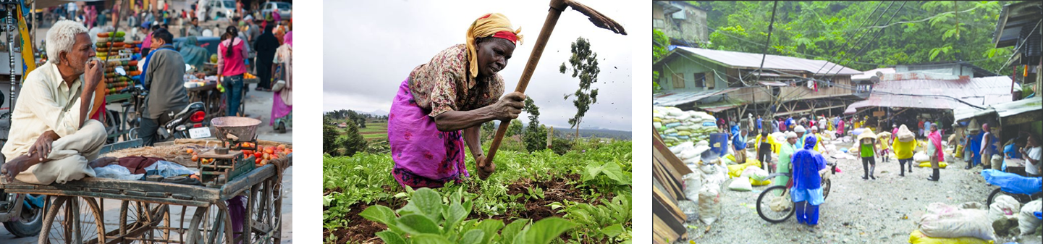
Reaching out to the informal economy: challenges
Poverty, low and irregular incomes
Diversity → different needs and concerns
Lack of clear representation
Lack of support from employers
Informal systems of social protection
Notes:
Diversity: Small traders – subsistence farmers – miners
Employers may have an interest in perpetuating informality (lower costs)
Informal systems of social protection risk ‘crowding out’ statutory systems of social protection

Slide 7
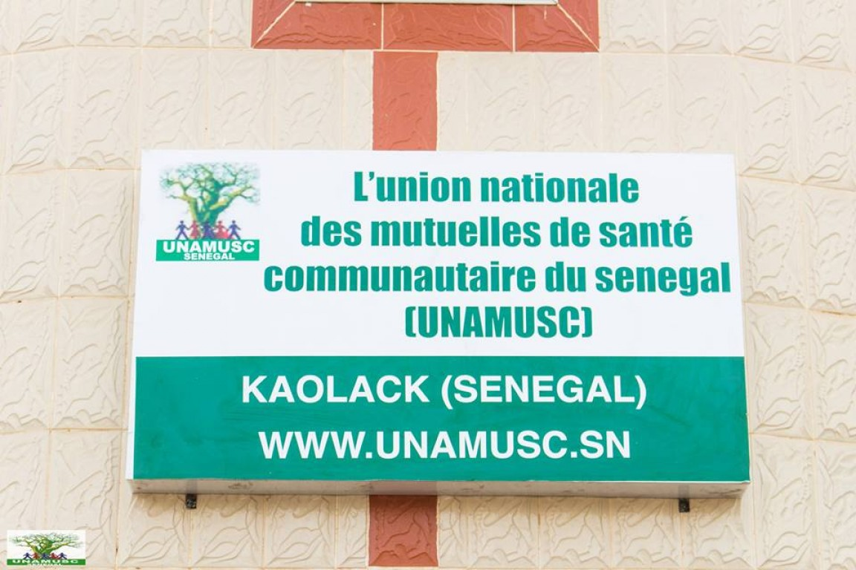
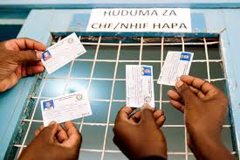
Case studies: CBHI in Senegal and Tanzania
How do CBHI-schemes reach out to their target population – the rural poor and people in the informal economy?

Slide 8
Community-Based Health Insurance
Key characteristics:
  Prepayment schemes that pool health risks at community level
  Relies (at least in part) on membership contributions
  Voluntary membership
  Not-for-profit
  Typically target rural/informal economy
Challenges with regards to enrolment and revenue collection
How do CBHI-schemes deal with challenges in the field of recruitment and revenue collection?
Notes:
Uptake amongst target population rarely exceeds 10%; drop-out is a pervasive problem; and revenue collection is inefficient

Slide 9
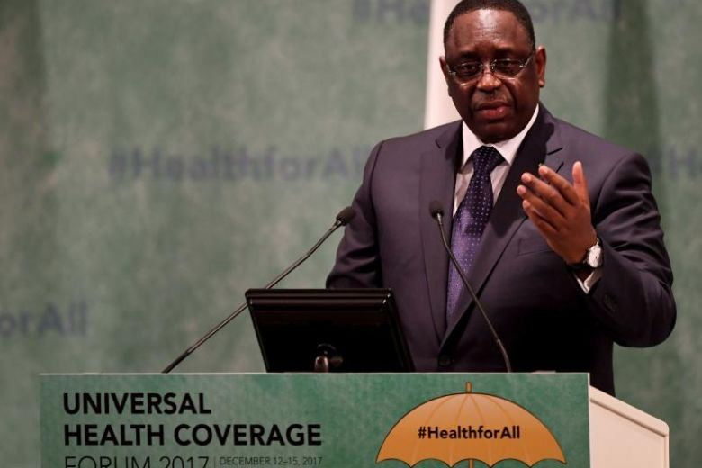
Case 1: Senegal
Long history of CBHI (Mutuelles de santé)
Long history of Belgian support for CBHI
Macky Sall (2012): “Achieve UHC by 2022”
→ CBHI as key instrument for reaching out to ‘le monde rural et le secteur informel’
  Government subsidies
  Complex institutional architecture
  that revolves around mutuelles de
  base (1 per commune)
Notes:
Belgian actors, including civil society and Belgian development agencies (BTC and UDAMs)

Slide 10
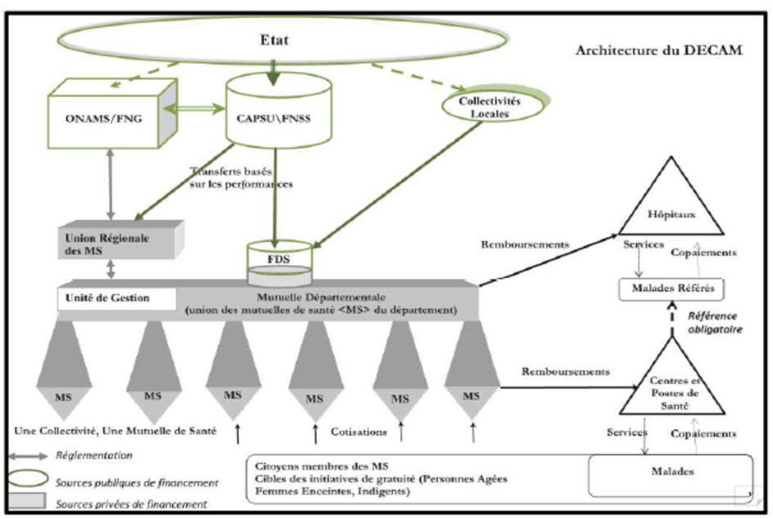
Case 1: Senegal
Notes:
Works at different levels and mimics structure of Senegalese state
BUT ultimately retains the idea of mutuelle as a community affair – difference with the initiative supported by BTC (UDAM), which is centered around the provincial level

Slide 11
Case 1: Senegal
Mutuelles facing massive challenges:
  Difficulties to attract and retain new members
  = low autonomous capacity for revenue mobilization
  Major problems with payment of subsidies and the weakness of overarching support structures
  = lack of external financial support
Notes:
Subsidies have been budgeted, but Agence CMU is not receiving them, and is therefore unable to pay the mutuelles. The sad result is that many mutuelles are now threatened in their existence.

Slide 12
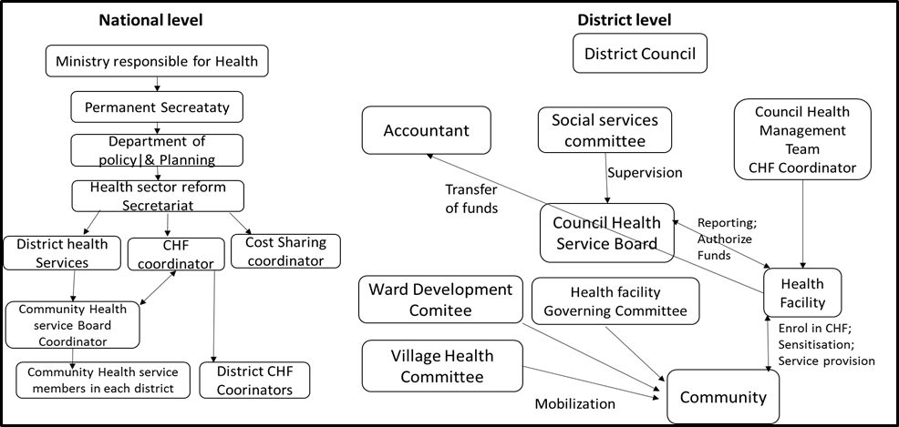
Case 2: Tanzania
Community Health Funds (CHF) as a reaction to liberalization of health care sector (1990s)
Government-led and -subsidized scheme

Slide 13
Case 2: Tanzania
Problems with scheme uptake (9,2% on average)
Now: ‘Improved CHF’ pilots → Redesigning the scheme:
  Improved management structures
  Increased premium prices
  Improved benefit packages
  Government subsidies maintained
  Involvement of private sector
    Work with private health care facilities
    Work with NGOs: HPSS (Dodoma) and PharmAccess (Kilimanjaro)

Slide 14
Case studies of 2 CHF-pilots
 | Improved CHF (CHF iliyoboreshwa) – Dodoma | Improved CHF (iCHF) – Kilimanjaro
Premium price | 10,000 TSH (5USD) per household (max. 6 members) per year | 30,000 TSH (15USD) per household per year
Benefits package | Primary health care at any public facilities (dispensaries and health centers) within the region. | Primary health care with referral and hospitalization (up to 3 days) at two selected public and/or private facilities within the district.
Reimbursement mechanism | Claims | Capitation
Ownership/ Management | Owned and managed by local government (district councils). The redesigning process was supported by HPSS project. | Co-managed by NHIF (managing finances), PharmAccess (provide technical support) and district councils (conduct awareness campaigns and appoint enrollment officers through village governments).

Slide 15
Case studies: 2 CHF pilots
Increased awareness about health insurance
Increased enrollment?
  Cumulative enrollment of about 20%
  Dropouts remain a challenge (50%)
  Actual enrollment below 10%
  Problems with government subsidies
Introduction of quasi-mandatory elements:
  Automatic registration of cash transfer recipients
  CHF-membership as prerequisite for access to health care in public facilities
  Social pressure to enroll (from political leaders and local government authorities)

Slide 16
Synthesis of case studies
CBHI integrated into national strategies for UHC
→ Move away from genuine CBHI?
Lack of government support (despite promises)
→ Continued importance of stable and autonomous capacity for recruitment and revenue collection
BUT critical challenges remain due to:
  Poverty; low and irregular incomes
  Geographical remoteness
  Difficulties reaching particular target groups
  Diversity in rural/informal economy
  Absence of decent health care services
Notes:
Remoteness: Particularly in rural areas
Target groups: men, poor and rich, migrants
Diversity → different needs and concerns (rural wage worker vs independent artisan)
Supply-side issues
HOW DO CBHI-MECHANISMS ATTEMPT TO TACKLE THESE CHALLENGES?

Slide 17
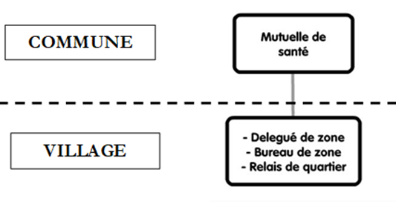
Coping strategies
Proactive recruitment strategies
Flexible enrollment and revenue collection:
  Alternative groups and indidivual enrolment
  Payment in installments
  Mobile payments
Deconcentration of recruitment and collection
Notes:
Promotional convoys, guichets
In both countries, the household remains the primary unit of enrolment but alternative groups, individual or group enrolment; paying in installments; payments by mobile phone
Deconcentration = devolving responsibility over specific tasks in the field of revenue collection/recruitment to persons or institutional structures at village or neighbourhood level

Slide 18
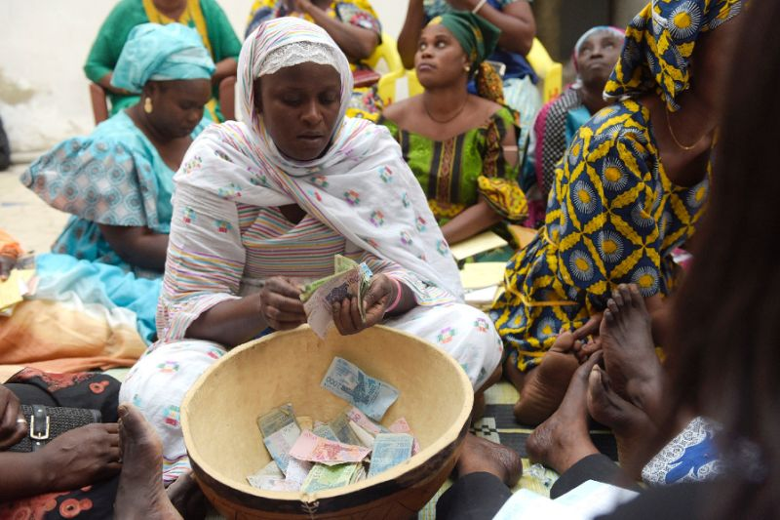
Coping strategies
Professionalization: reliance on trained (and salaried?) staff
‘Couplage’: couple health care to other services
Work through local social networks
Mobilize support from politicians
BUT instrumentalization
Notes:
Professionalization: CHF-managers and enrolment officers; UDAM
Social networks: women groups (tontine de santé), religious associations, cooperatives
Political instrumentalization may in turn affect ability of mutuelles to reach out to target population because CBHI becomes associated with this or that politician and his/her patronage networks.

Slide 19
What role for external actors?
Recommendations and critical reflections

Slide 20
Recommendations
(1) Targeted technical and financial support for more effective (professional?) recruitment and revenue collection
(2) Politically smart interventions that mobilize political support while minimizing risk of instrumentalization
(3) Develop comprehensive approach that:
    Looks at supply side
    Minimizes fragmentation in social (health) protection
Notes:
(2) CBHI is often seen as an apolitical affair, but in reality it is not → critical engagement with local politicians

Slide 21
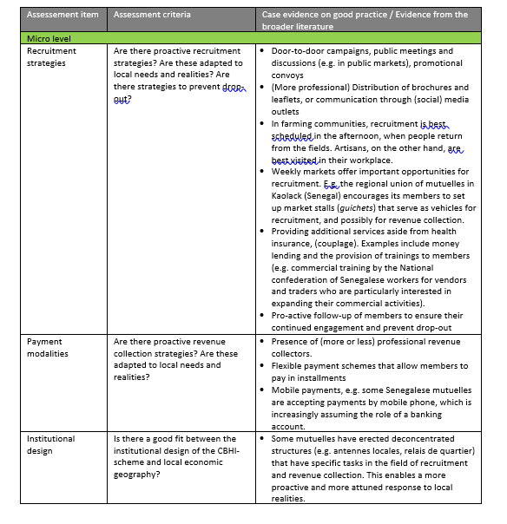
Participatory planning- and assessment tool
Notes:
Should enable a critical reflection and self-assessment about revenue collection and recruitment strategies for actors on the ground, based on different assessment items and criteria, and evidence (both from field research and literature) about good practices.
Feedback would be more than welcome, but given the specificity of the tool, we will not discuss it further here

Slide 22
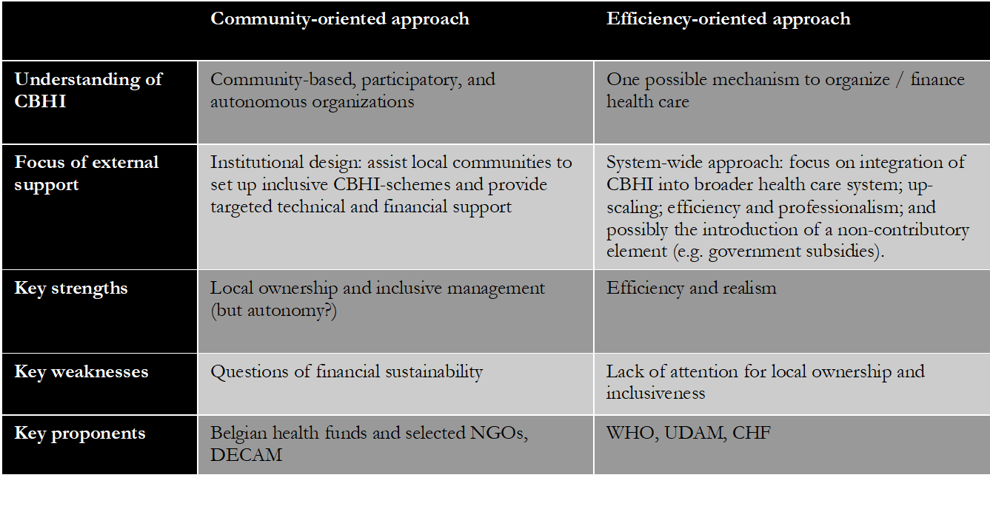
External support and fragmentation
Notes:
Within policy and advocacy circles, there exist competing views of what CBHI is, and how it should be supported. Here, we have attempted to summarize the two main approaches
→ Do note that these are ideal-types rather than mutually exclusive categories, and in many countries (including Senegal and Tanzania) we now find a trend towards hybridization

Slide 23
External support and fragmentation
Senegal: Belgian actors supporting both approaches (mutuelles vs UDAM)
Tanzania: different (competing?) pilots supported by different external actors
Is there room for a ‘rational approach’ that builds on combined strengths of both approaches?
What could such an approach look like?
How can different stakeholders contribute to its implementation?
Notes:
Tanzania: Now attempts to move towards a more streamlined/homogeneous approach

Slide 24
THANK YOU

